Slide 1
Are Convolutional Neural Networks or Transformers more like human vision?
Authors: Shikhar Tuli, Ishita Dasgupta, Erin Grant, Thomas L. Griffiths
By: Talha Altaf k67896
Jaiki K67913

Slide 2
Introduction
CNNs dominate computer vision tasks but have limitations like texture bias.
Transformers (e.g., Vision Transformer, ViT) introduce a flexible attention mechanism.
Aim: Compare Vision Transformers (ViTs) and CNNs in human-like classification behavior.

Slide 3
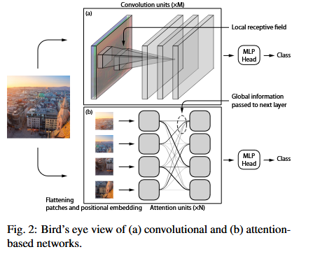
Convolutional and Attention-based networks

Slide 4
Convolution vs. Attention
Convolutional Neural Networks:
  Inspired by the primate visual system.
  CNNs excel at extracting localized features due to translational invariance.
Transformers (e.g. ViTs):
  ViTs use self-attention for flexible feature learning, offering global context.
  ViTs outperform CNNs in certain vision tasks.

Slide 5
Methods
Models:
  CNN: ResNet
  Transformer: ViT (different configurations).
Dataset:
Stylized ImageNet (SIN) for shape-texture conflict analysis.

Slide 6
Measuring Error Consistency
Error consistency examines patterns of correct and incorrect classifications.
Metrics used: Cohen’s κ and Jensen-Shannon (JS) distance.
Prior studies comparing neural networks and people have employed Cohen's κ, which just evaluates if the classification was accurate or not.
JS distance focuses on and captures granular misclassification patterns better than Cohen’s κ.

Slide 7
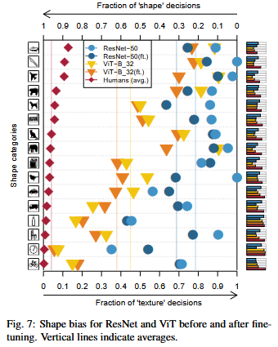
Results: Shape Bias
CNNs rely on texture, whereas humans and ViTs prioritize shape.
ViTs demonstrate higher shape bias after fine-tuning than CNNs.

Slide 8
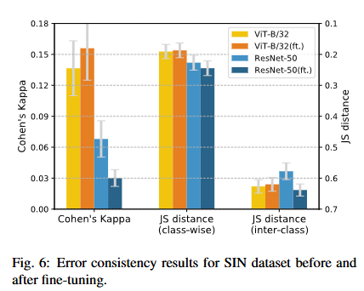
Results: Error Consistency
ViTs show higher consistency with human errors than CNNs.
JS distance provides insights into misclassification patterns beyond accuracy.

Slide 9
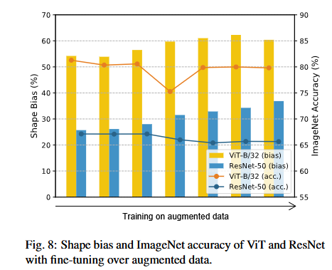
Fine-Tuning with Augmented Data
Augmented data (Color jitter, Gaussian noise, rotation, Sobel filtering) increases shape bias and affects accuracy.
ResNet shows reduced error consistency, while ViTs maintain or improve human-like behavior.

Slide 10
Conclusion
ViTs outperform CNNs in human-like error consistency and shape bias and accuracy.
Future directions:
  Exploring architectural features and new error metrics.
  Compare ViTs with other architectures (e.g., iGPT).
  Investigate concept-level classification biases.

